Slide 1
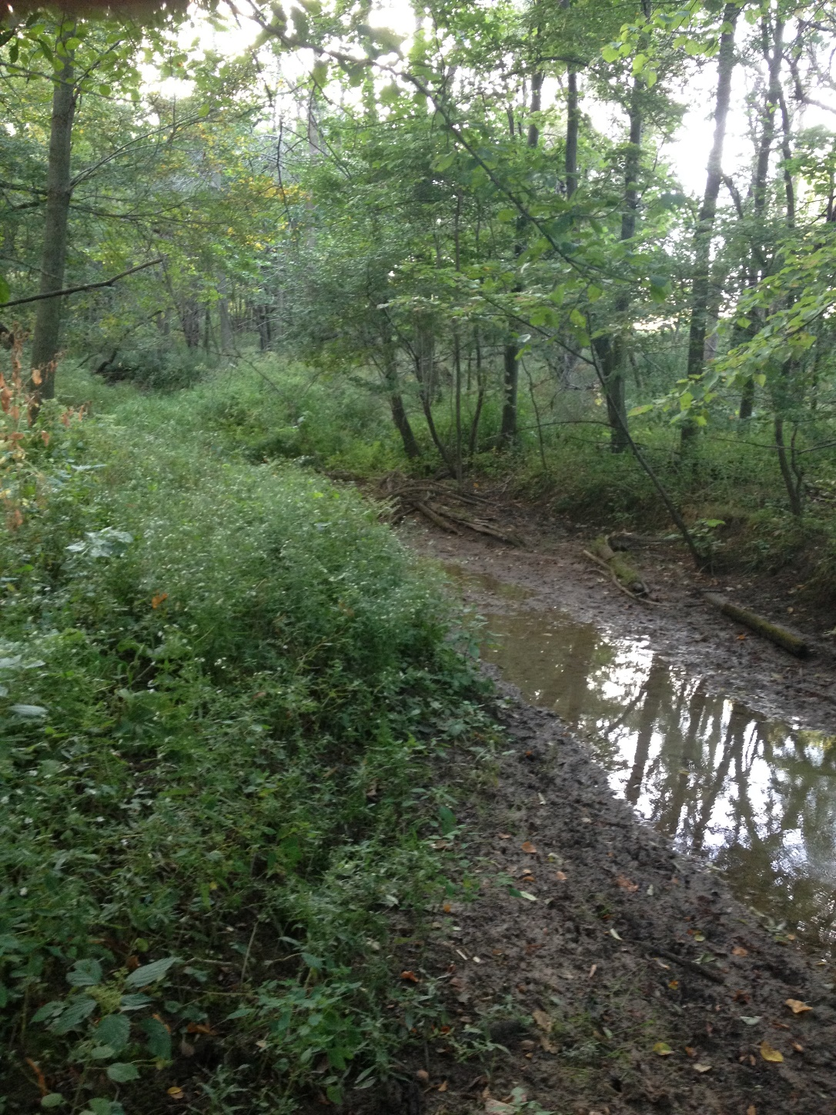
This Paradise
Remembers the cadence of forgotten songs,
Memorizes the palpitation of muffled heartbeats,
Illuminates the darkness entangled in our doubts,
Revives the magic of dormant hope;
Strips fabrications to the raw beauty of nature,
Rekindles the joy of our captive spirits,
Excavates the iridescence of love,
Gives a voice to silenced souls.

Slide 2
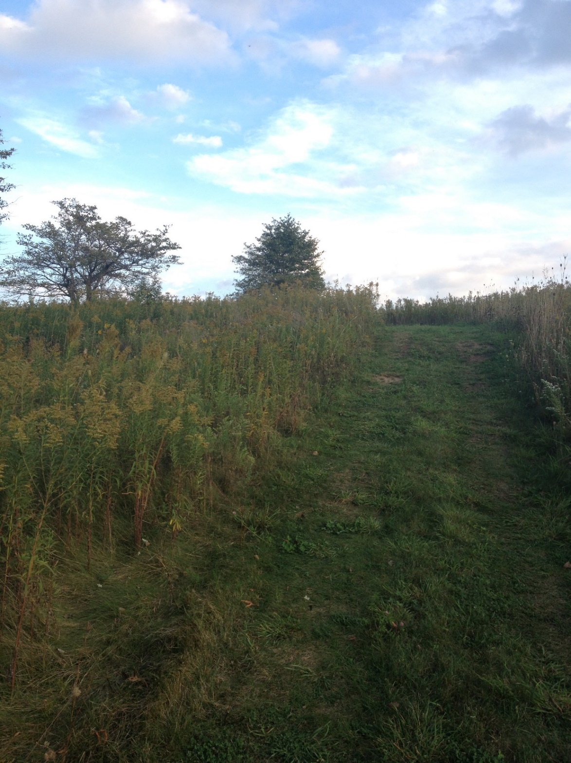
Heights of Dreams
What if you let go
Of the fears that paralyze you?
What if you grasped the liberation
Of wishes pulsing through your veins?
What if you discovered wings of courage
To give motion to your imagination?
What if you found enough faith
To reach for wispy clouds of possibilities?
What if you trusted the wind
To propel you to the heights of your dreams?

Slide 3
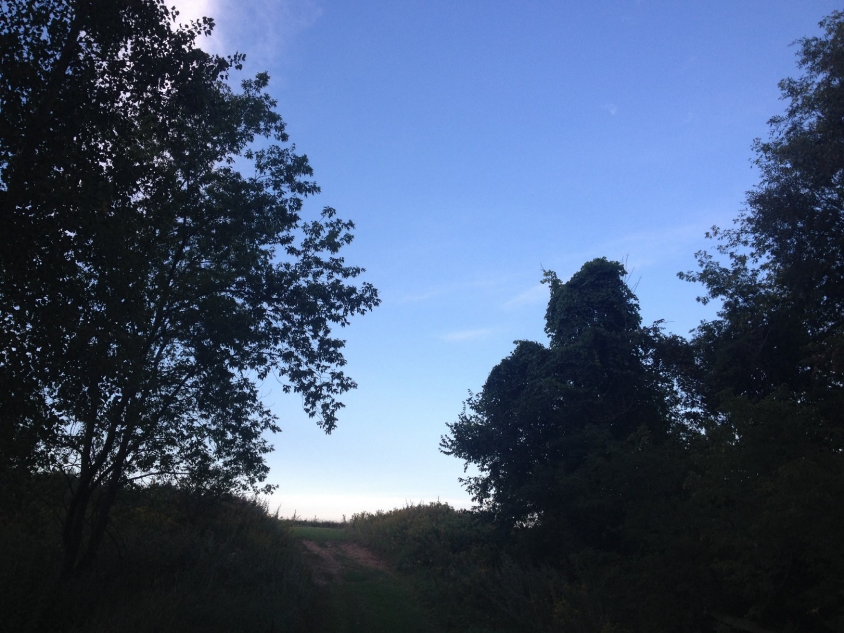
Songs of Nightfall
The enticing music of this moment—
The orchestra of a single breath—
Echoes across acres of silence
And caresses the one mind that has forgotten the melody.
This lilting lullaby resonates in the lonely dusk,
Serenades the horizon’s awe-inspiring aura:
A chorus of love becomes entangled
In the tapestry of my heartstrings.

Slide 4
Set My Soul Free
As whispers of tomorrow crystallize in periwinkle bliss,
Suppressed lyrics of my spirit become a raw reverberation:
The iridescent skyline is a portal
To twilight’s tantalizing liberation.
Sunset’s serenity awakens silhouettes of the past,
Illuminates shadows of the person I used to be.
For the first time, I am fearless:
Breathless beauty sets my soul free.

Slide 5
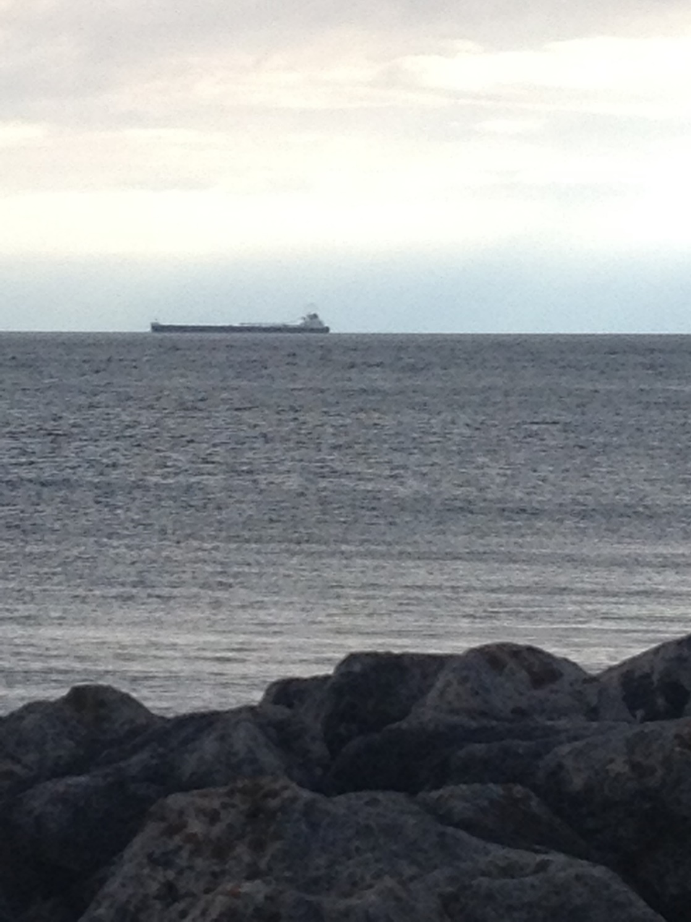
All That Matters
All that matters is the magic of this memory:
Opaque clouds stretching farther than our imaginations,
The cadence of lucid water,
And our all-encompassing faith—
A force as powerful
As the mesmerizing motion
That drives the incessant rhythm of waves.
All that matters is this moment.

